Slide 1
PerfTest: Setup (WSAS)
Yoonki Song
Last Updated: Sep. 22, 2009

Slide 2
Outline
Download Packages from IBM Academic Initiative
WebSphere Application Server (WSAS) v6.1
Rational Performance Tester (RPT) Agent v8.0
Install Packages on the Server side
WSAS v6.1
RPT Agent (with DCI) v8.0
Install Packages on the Client side
RPT (with Agent) v8.0

Slide 3
IBM Academic Initiative
Query: “WebSphere Application Server v6.1”
WebSphere Application Server V6.1 for Linux on x86Series Multilingual eAssembly (CR3ADML)
Part: WebSphere Application Server V6.1 for Linux on x86Series, 32-bit Support (C87QXML)
Part: WebSphere Application Server V6.1 for Windows on x86Series, 32-bit Support (C87QTML)
Part: WebSphere Application Server V6.1 Supplements Application Client, IBM HTTP Server, Web Server Plug-ins, Installation Factory, Migration Tool, IBM Support Assistant and Update Installer for Linux on x86Series, 32-bit Support Multilingual (C87PSML)

Slide 4
IBM Academic Initiative (Cont’d)
Part Information (in detail)
http://www-01.ibm.com/support/docview.wss?rs=180&uid=swg27007743

Slide 5
IBM Academic Initiative (Cont’d)
Query: “Rational Performance Tester V8.0”
IBM Rational Performance Tester V8.0 Multiplatform Multilingual eAssembly (Core) (CR7VNML) <- RPT Agent (Link Error?)
IBM Rational Performance Tester V8.0 for z/OS Multiplatform Multilingual eAssembly (Core) (CR7XFML) <- RPT (Link Error?)
Part Information (in detail)
http://www-01.ibm.com/support/docview.wss?rs=180&uid=swg27007743

Slide 6
WebSphere Application Server v6.1
Installation and Configuration on the Server side

Slide 7
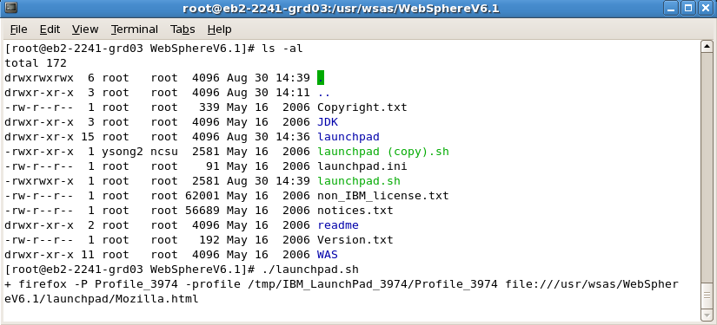
WSAS Installation
# ./launchpad.sh

Slide 8
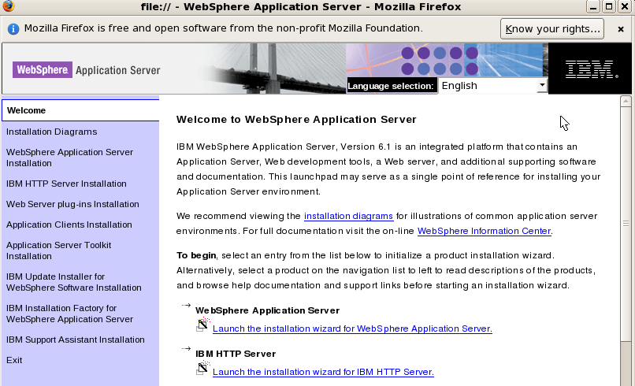
WSAS Installation (Cont’d)
Launch the installation wizard for WebSphere Application Server

Slide 9
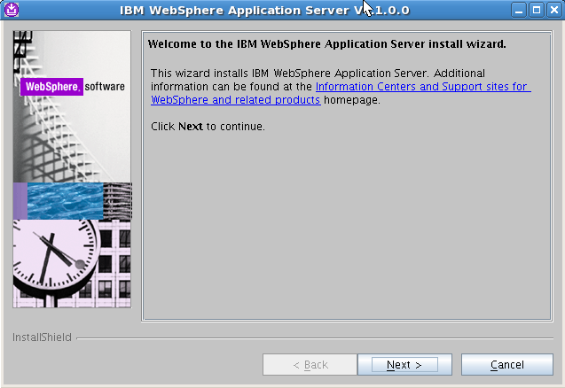
WSAS Installation (Cont’d)

Slide 10
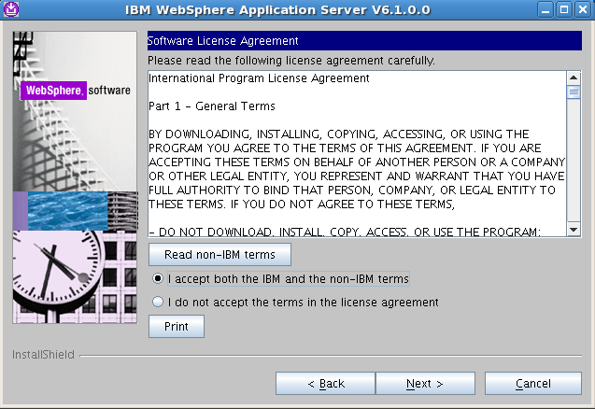
WSAS Installation (Cont’d)

Slide 11
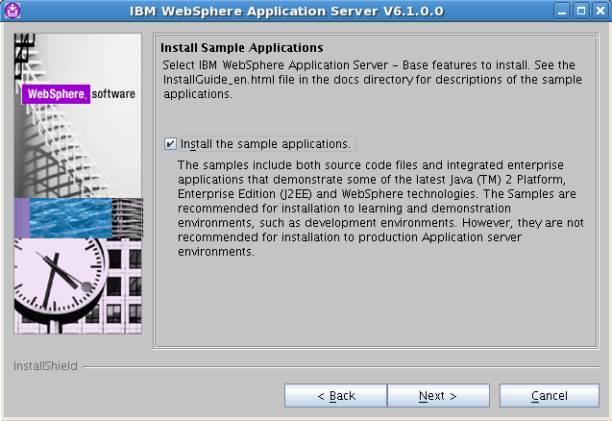
WSAS Installation (Cont’d)

Slide 12
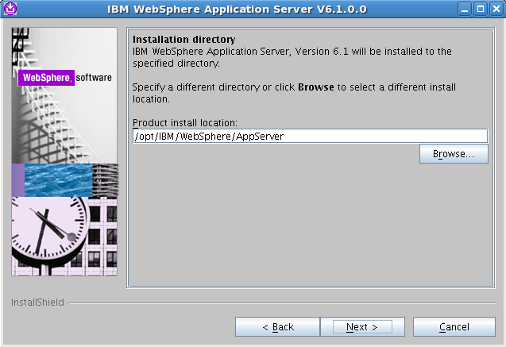
WSAS Installation (Cont’d)

Slide 13
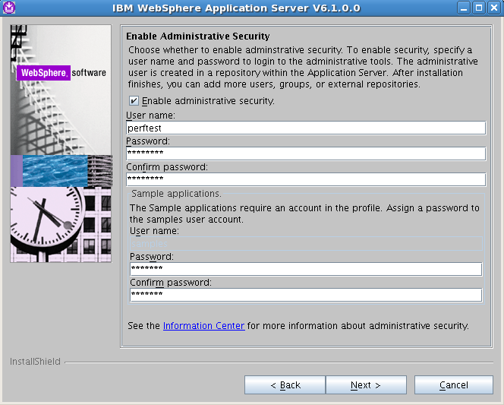
WSAS Installation (Cont’d)
perftest
perftest
perftest
samples
samples
samples

Slide 14
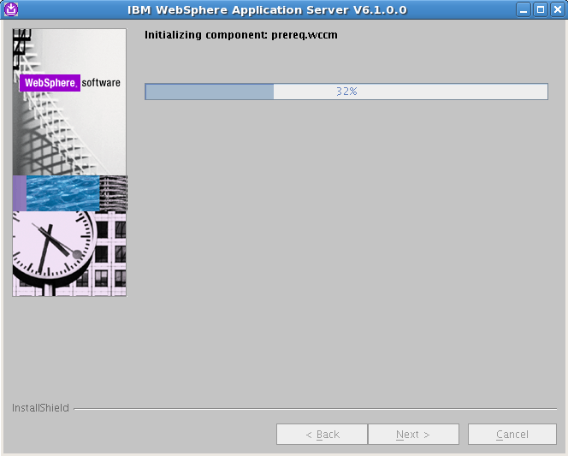
WSAS Installation (Cont’d)

Slide 15
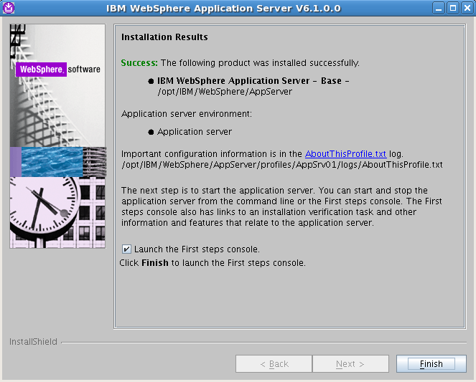
WSAS Installation (Cont’d)

Slide 16
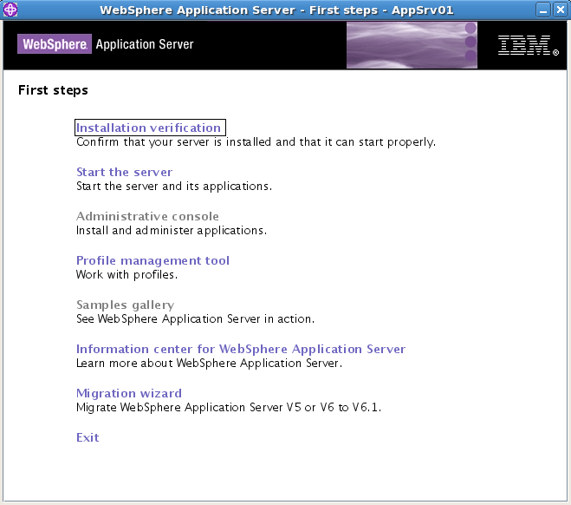
Installation Verification

Slide 17
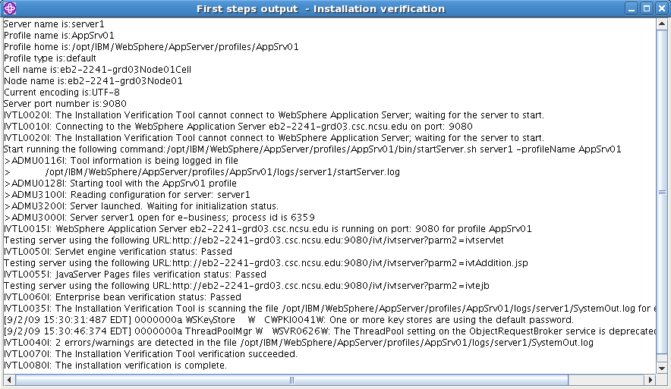
Installation Verification (Cont’d)

Slide 18
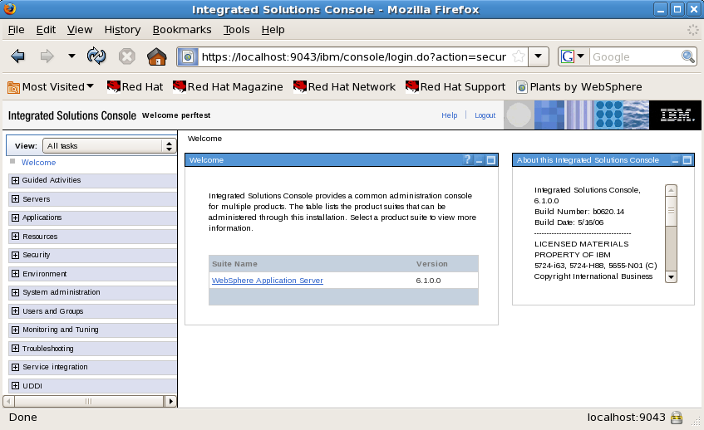
Administrative Console

Slide 19
Uninstallation (Optional)
Uninstall
/opt/IBM/WebSphere/AppServer/uninstall/uninstall -silent

Slide 20
IBM WebSphere Application Server commands
Start the IBM WebSphere Application server
/opt/IBM/WebSphere/AppServer/bin/startServer.sh server1
Stop the IBM WebSphere Application server
/opt/IBM/WebSphere/AppServer/bin/stopServer.sh server1
Check status of the IBM WebSphere Application Server
/opt/IBM/WebSphere/AppServer/bin/serverStatus.sh server1
Regenerate the Web server plug-in config file (which connects WAS to the Web Server)
/opt/IBM/WebSphere/AppServer/bin/GenPluginCfg.sh
Use the IBM WebSphere command line administration tool
/opt/IBM/WebSphere/AppServer/bin/wsadmin.sh

Slide 21
Using WSAS Administrative Console
Check the status of the application server:
/opt/IBM/WebSphere/AppServer/bin/serverStatus.sh server1
If the status replies that the Application server “server1” is not started:
/opt/IBM/WebSphere/AppServer/bin/startServer.sh server1
Start Firefox in the background:
firefox &
To open the administrative console, enter the URL:
http://localhost:9090/admin

Slide 22
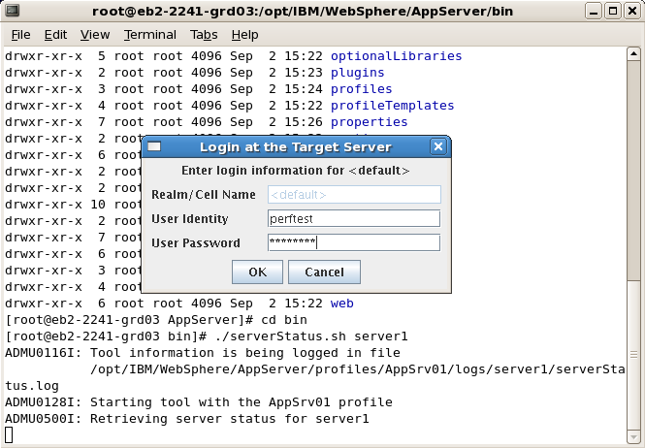
Starting WSAS
perftest
perftest

Slide 23
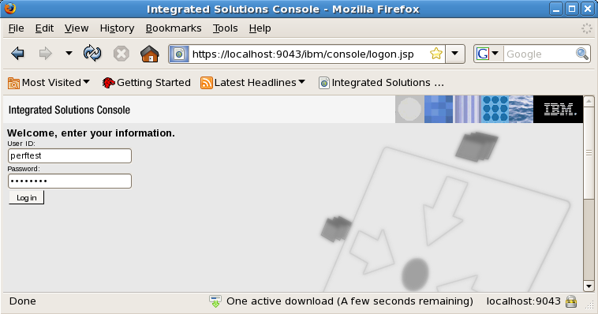
Starting WSAS
perftest
perftest

Slide 24
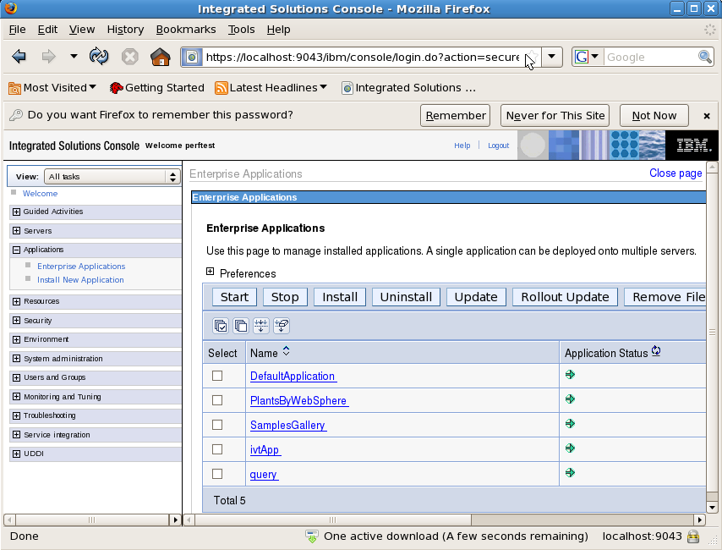
Starting WSAS
[Source Code] /opt/IBM/WebSphere/AppServer/samples/src/PlantsByWebSphere

Slide 25
Starting WSAS
Start the AC on the server
/opt/IBM/SDP/AgentController/bin/ACStart.sh
…

Slide 26
Export LD_LIBRARY_PATH
export
LD_LIBRARY_PATH=/usr/local/lib:${LD_LIBRARY_PATH}
To permanently set it for all users.
$ su -
Password:
# cd
/etc/ld.so.conf.d
# echo /usr/local/lib >local.conf
# exit

Slide 27
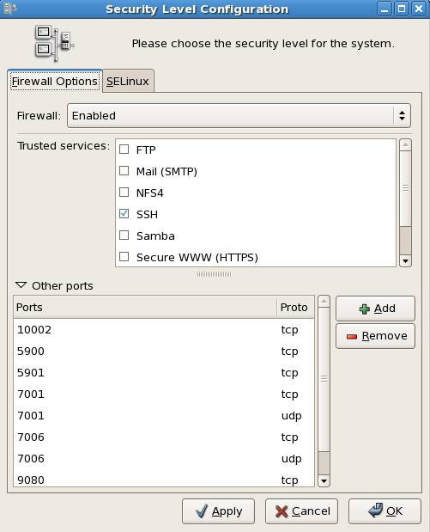
Ports should be opened
9080
system-config-securitylevel

Slide 28
Trouble Shooting

Slide 29
Trouble Shooting
ADMU3011E: Server fails to start on Linux platforms
http://www-01.ibm.com/support/docview.wss?uid=swg21287231
JVMJ9VM011W: Unable to load piAgent
http://www-01.ibm.com/support/docview.wss?uid=swg21288832 (Bad)
http://www-01.ibm.com/support/docview.wss?rs=180&uid=swg21246403 (Bad)

Slide 30
After profiling, the server is down
Trace data seems to be not enough

